Slide 1


FPT UNIVERSITY
MAI391 PROJECT
REPORT
SPAM EMAIL DETECTION
Class : AI18C
Group: 03

Slide 2






MEMBERS
Nguyen Tan Thang
-QE180019-
Nguyen Quoc Nhut
-SE181753-
Pham Thi Kim Oanh
-QE180218-
Võ Quang Triều
-QE180133-
Do Thi Quynh Nga
-QE180219-
Nguyen Tran Truong Chinh
-QE180191-

Slide 3
1. Project Overview
2. Assign Task
3. Prepare Data & Clean Data
4. Exploratory Data Analysis
5. Building Model
6. Conclusion
CONTENT

Slide 4
1. Project Overview

Slide 5

1.1. Problem statement
Spam emails cause significant disruption, security risks, and annoyance to users. This project aims to develop an effective spam email classification model using machine learning to improve the accuracy of detection and minimize the impact of spam on users.

Slide 6
1.2. Research topic
Developing a spam email classification system using machine learning.
The machine learning algorithm utilized here is the Naive Bayes algorithm.

Slide 7
2. Assign Task

Slide 8
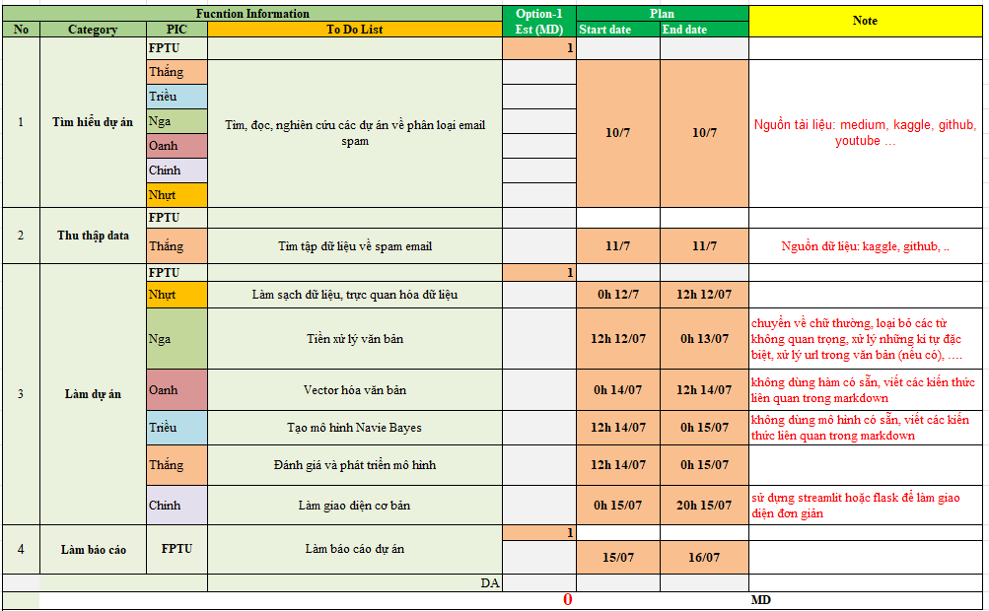

Slide 9
3. Prepare Data & Clean Data

Slide 10
3.1. Data source
Data link: https://www.kaggle.com/datasets/satyajeetbedi/email-hamspam-dataset
Kaggle provides a rich source of resources with thousands of datasets across various fields. We have searched and selected a dataset on this platform.

Slide 11
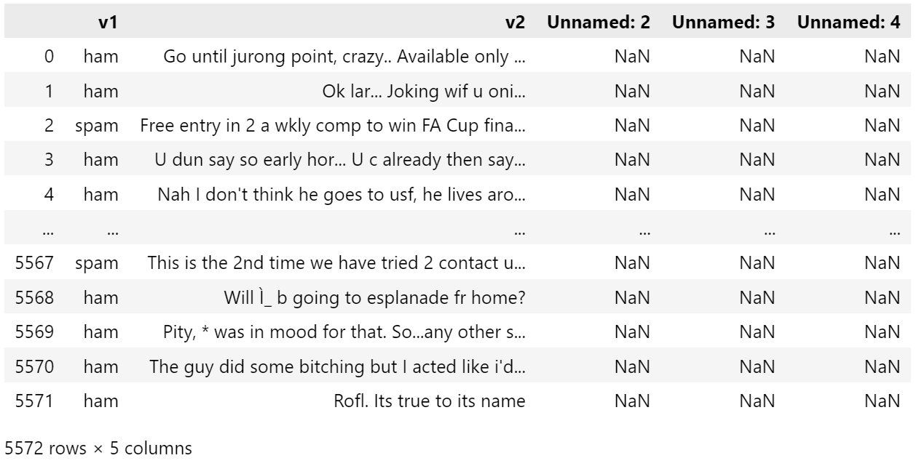
3.2. Dataset Overview
The dataset has 5572 rows and 4 colums.

Slide 12
3.3. Data Preprocessing
Remove columns with all NaN values.
Rename columns v1, v2 to label and message.
Drop rows with null values.
Drop duplicate values in the message column, keeping the first occurrence.
Encode labels in the label column: 1 for spam and 0 for normal.

Slide 13
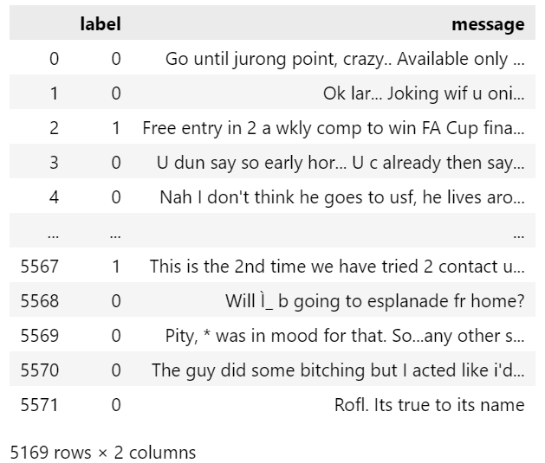
3.3. Data Preprocessing
Data after cleaning

Slide 14
4. Exploratory Data Analysis

Slide 15
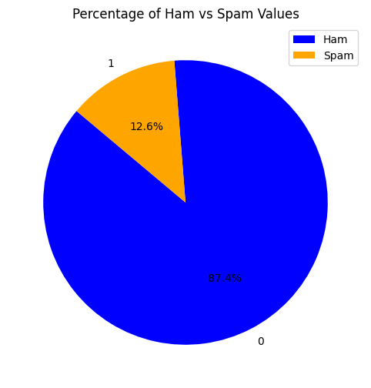
4.1. Data Visualization

Slide 16
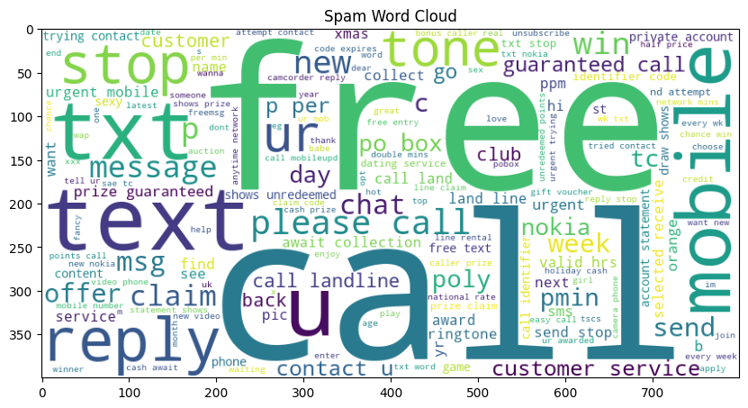
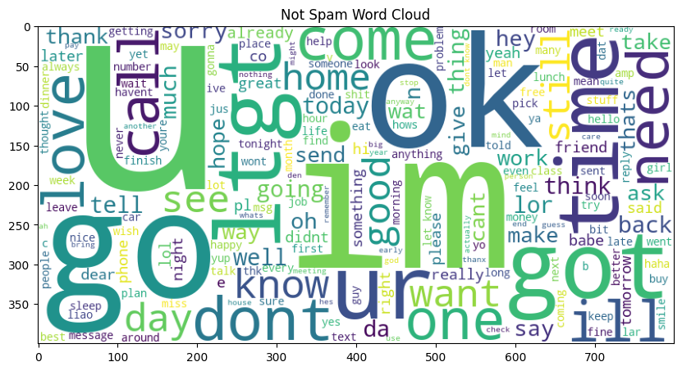
4.2. Spam vs Non-Spam Email Characteristics
Word cloud of words in spam email and non-spam email

Slide 17
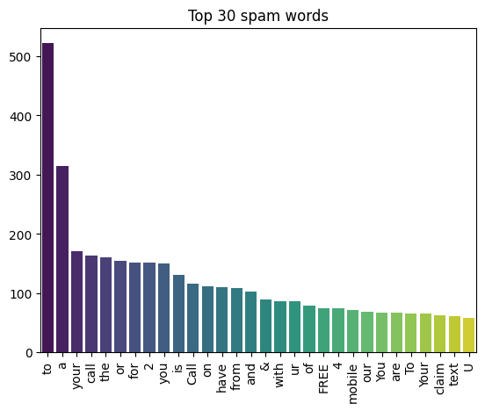
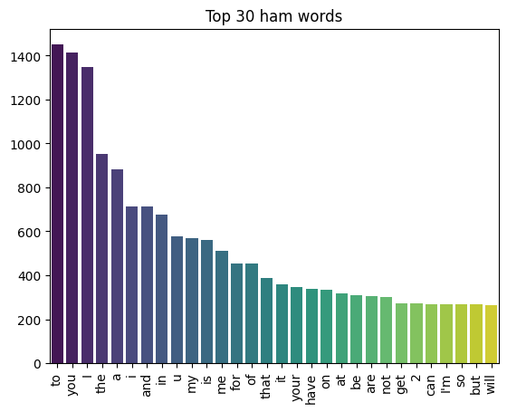
4.2. Spam vs Non-Spam Email Characteristics
Top 30 words in spam email and non-spam email

Slide 18
5. Building Model

Slide 19
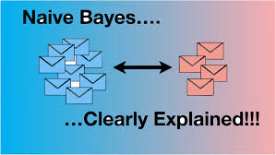
5.1. Model Selection
Introduction to Multinomial Naive Bayes
Naive Bayes is a classification algorithm based on Bayes' theorem with the "naive" assumption that features in the data are independent of each other.
Multinomial Naive Bayes is a variant of the Naive Bayes algorithm specifically designed to handle discrete data

Slide 20
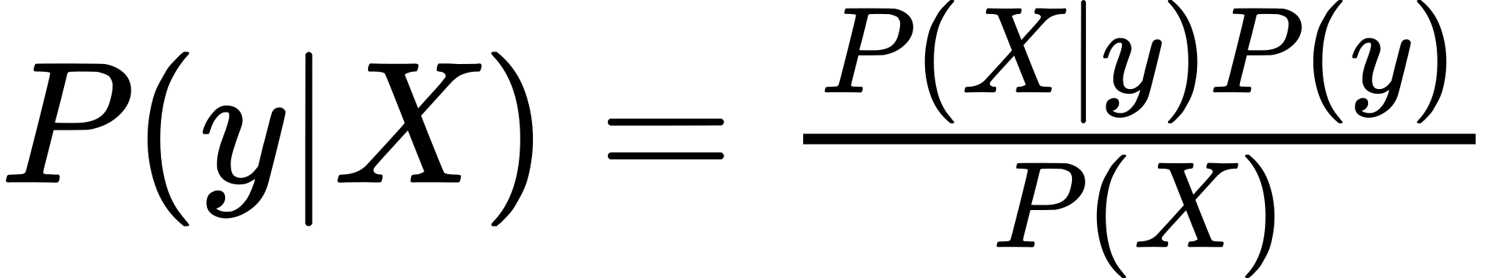
5.1. Model Selection
Naive Bayes:
- P(y|X) is called the posterior probability: the probability of target y given the feature X.
- P(X|y) is called the likelihood: the probability of feature X given the target y.
- P(y) is called the prior probability of the target y.
- P(X) is called the prior probability of the feature X.

Slide 21

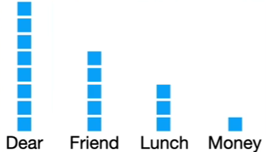

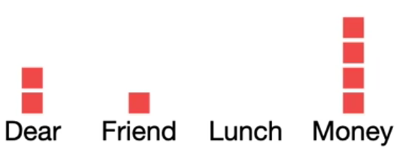
5.1. Model Selection
Example:

Slide 22

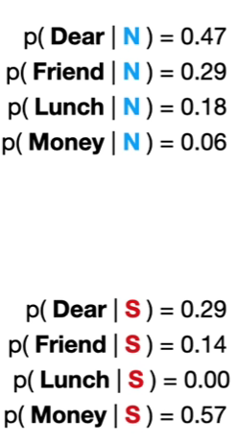

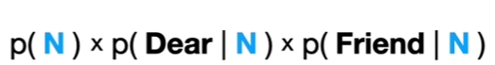
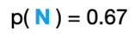
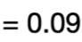
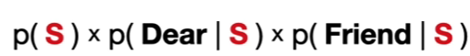
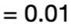


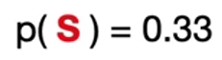
5.1. Model Selection
>

Slide 23
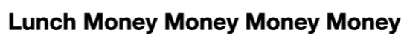
5.1. Model Selection
>

Slide 24
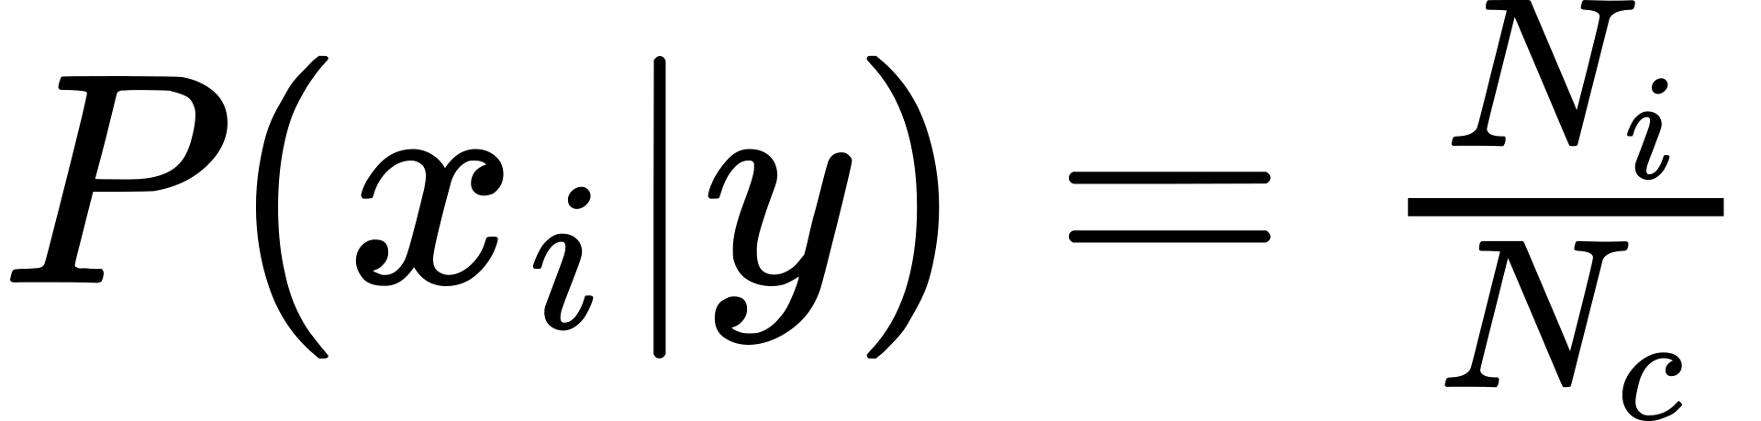
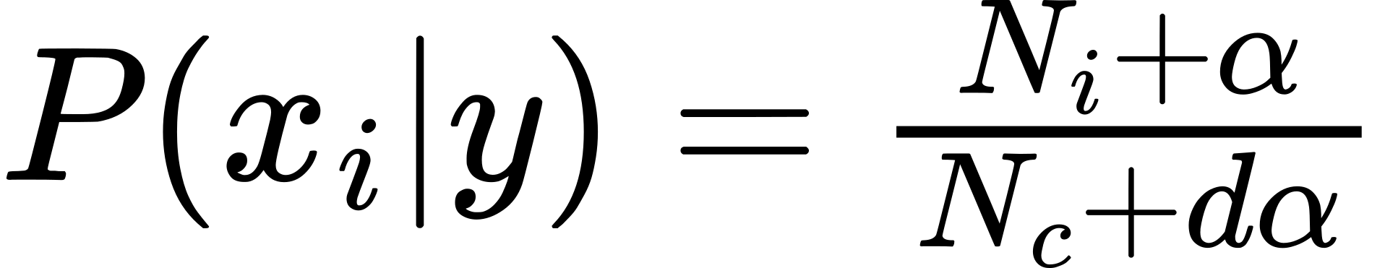
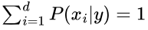
5.1. Model Selection
Multinomial Naive Bayes:
Probability of a word in text:
- Ni is the total number of times the term xi appears in the text.
- Nc is the total number of times all terms x1,...,xn appear in the text.
Laplace smoothing technique:
- α (smoothing parameter) is typically a positive number, often equal to 1.
- dα is added to the denominator to ensure ussually is total numbers of words.

Slide 25
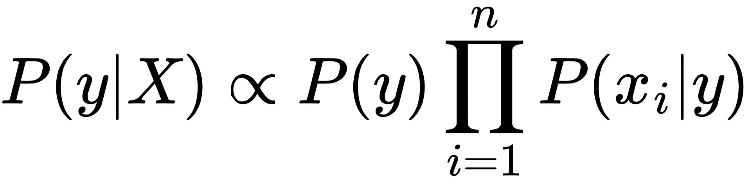

5.1. Model Selection
Multinomial Naive Bayes:
Here, X represents the feature vector, which can be written as:
In that case, Bayes' theorem becomes:

Slide 26
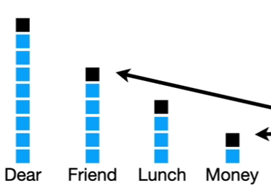

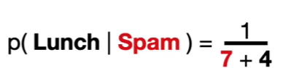
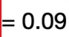
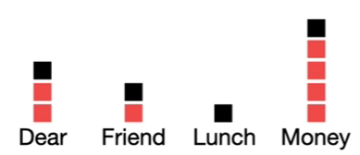
5.1. Model Selection

Slide 27
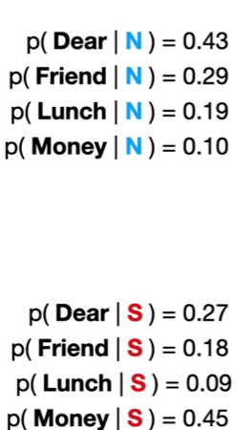
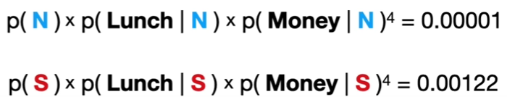

5.1. Model Selection
>

Slide 28
5.2. Text Preprocessing
Lowercase the text
Remove URL in message.
Remove special characters
Remove extra spaces.
Remove stopwords
Remove numerics value
=> Used for noise reduction, reducing data size make it easier to build models.

Slide 29
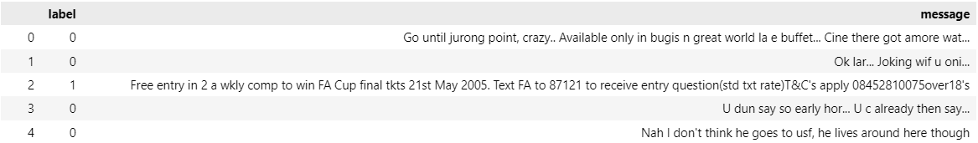
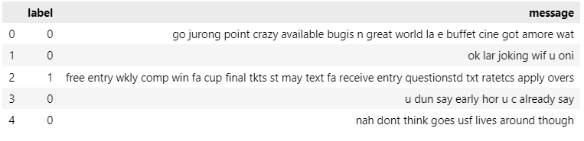
5.2. Text Preprocessing
Before:
After:

Slide 30
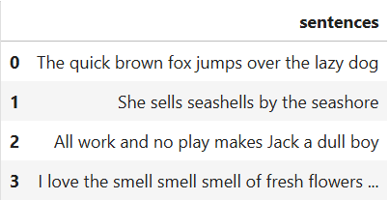

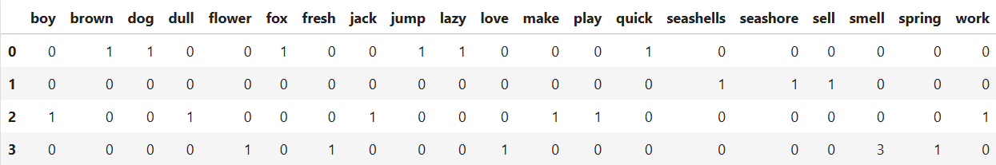
5.3. Text Vectorization
CountVectorizer is a pre-processing technique used to convert text data into numerical form.

Slide 31
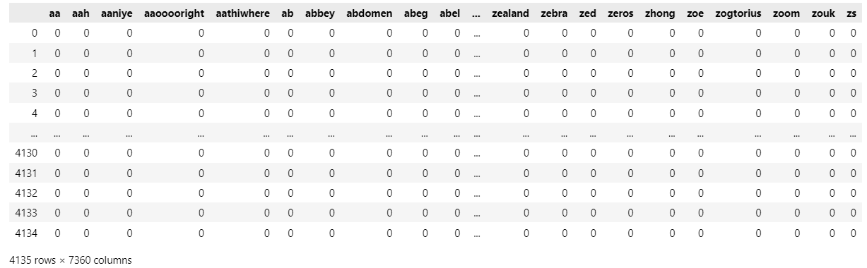
5.3. Text Vectorization
Apply CountVectorizer into email_spam dataset

Slide 32
5.4. Building and Training Multinomial Navie Bayes Model
The mathematical formulas for Multinomial Naive Bayes as previously outlined are used to build the model.
Underflow: Because P(X|y) is often the product of many probabilities P(x_i|y), as the number of features x_i increases, the product of small probabilities can become extremely small, leading to numerical underflow issues on computers.
Log transform: solving underflow issue
(In machine learning log mean logarit nepe)

Slide 33
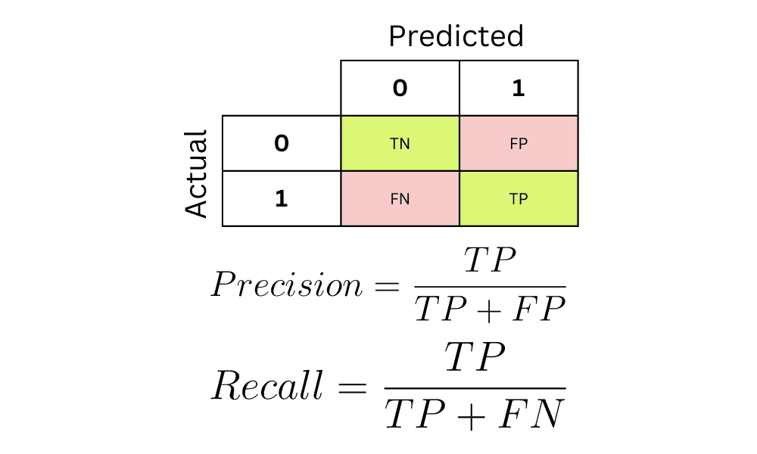
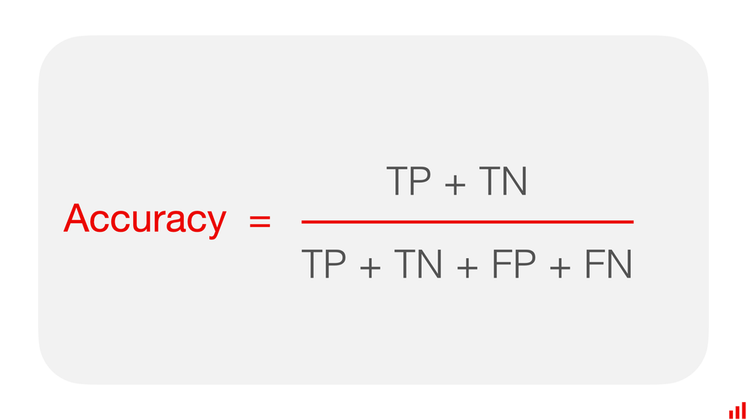
5.5. Evaluating Model Performance
Confusion matrix: Display the number of correct and incorrect predictions
Accuracy score: The ratio of the number of correct predictions to the total number of samples

Slide 34
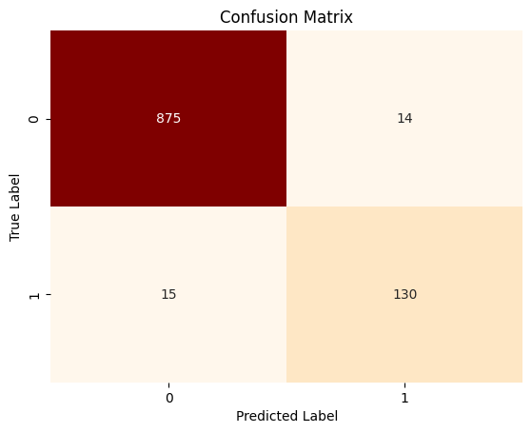
5.5. Evaluating Model Performance
Confusion matrix and accurency of the model
Accurency = 0.971

Slide 35
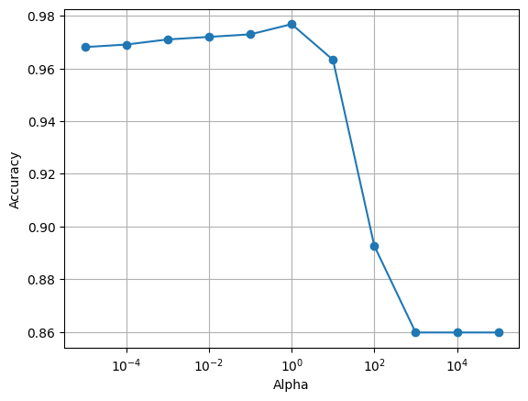
5.6. Model Optimization
Try smoothing parameter from 10^-5 to 10^5.
Best smoothing parameter = 1

Slide 36

5.6. Model Optimization
Confusion matrix after optimization.
Accurency = 0.976

Slide 37
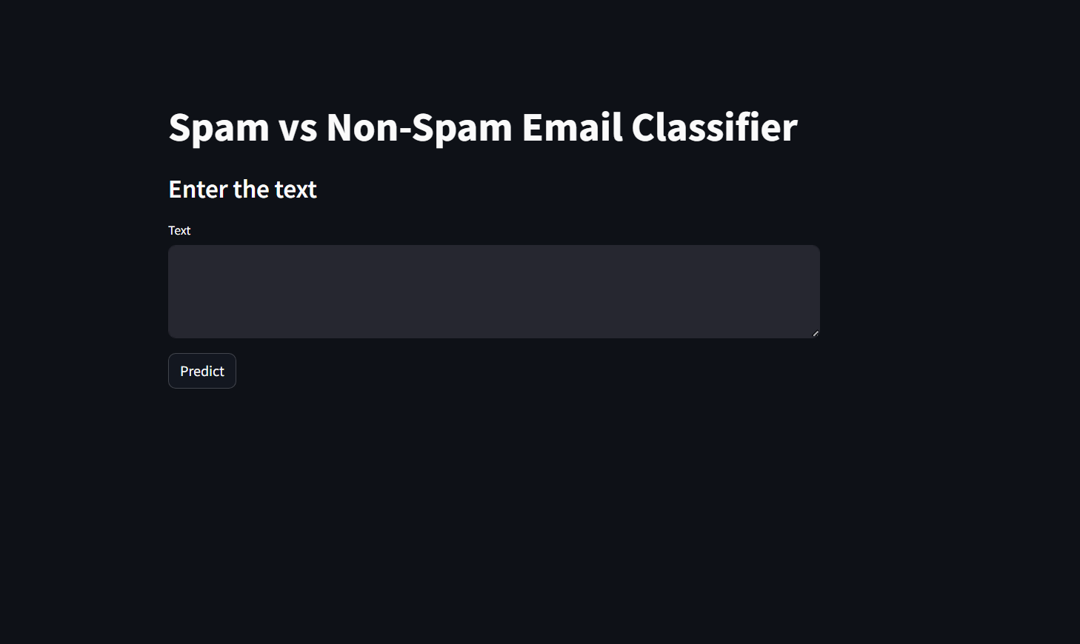
5.7. Creating UI
Use streamlit in python to create a simple webapp.

Slide 38
6. Conclusion

Slide 39
Through this project, we have:
Researched and understood the Naive Bayes algorithm.
Text preprocessing before building the model.
Building a Multinomial Naive Bayes model.
Creating an interface to apply the model.

Slide 40
THANK YOU

